Slide 1
RCCD Application & Credit for Articulation Application
Guide To…
Completion for HS Articulation

Slide 3
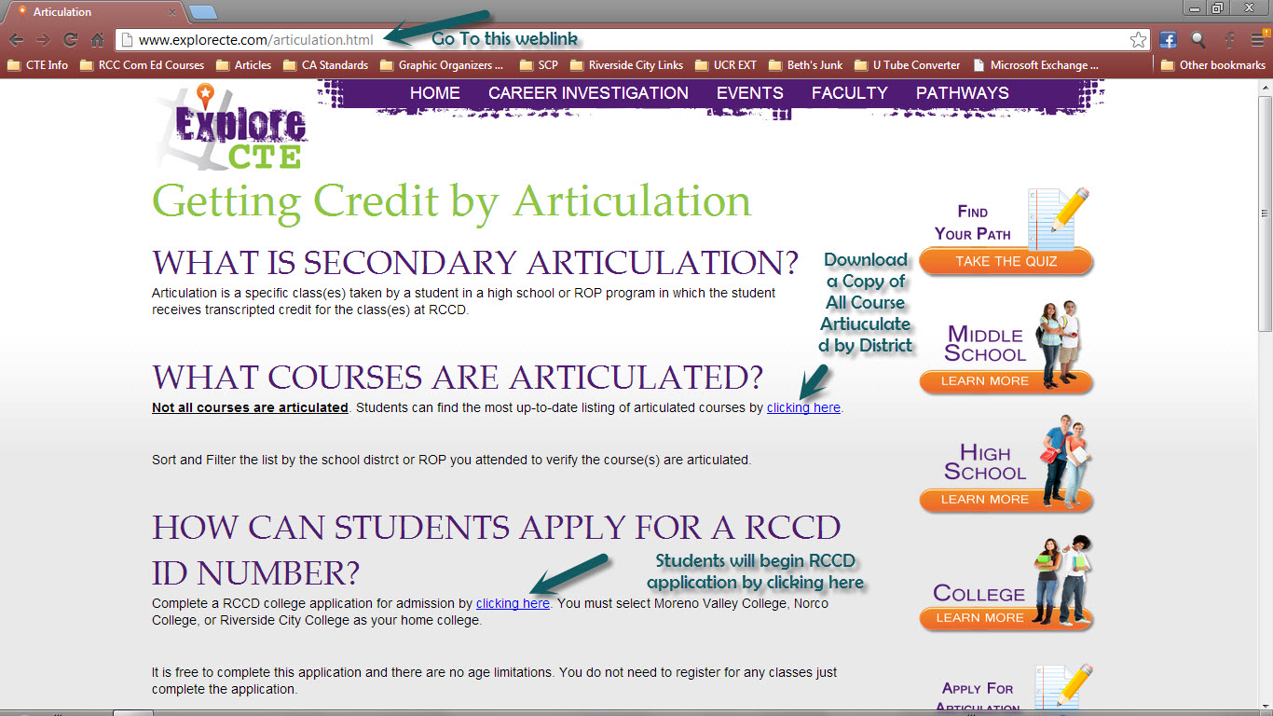
Download a copy of articulated courses by district

Slide 4
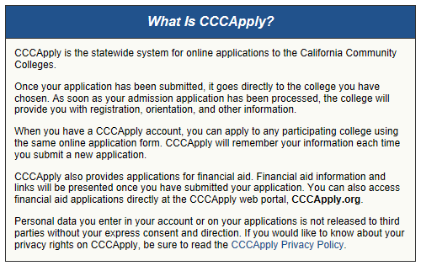

Slide 6
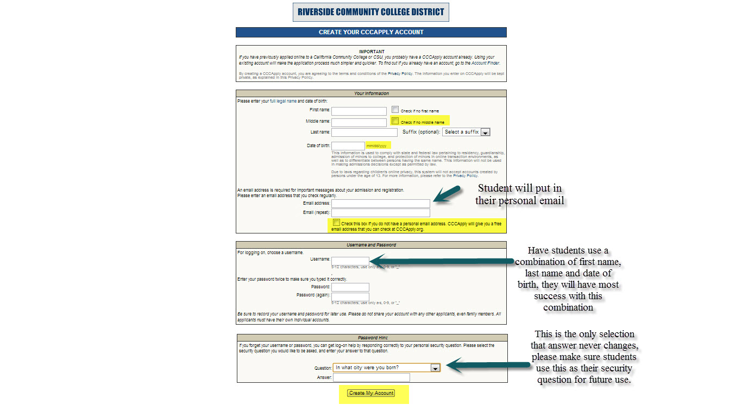

Slide 7
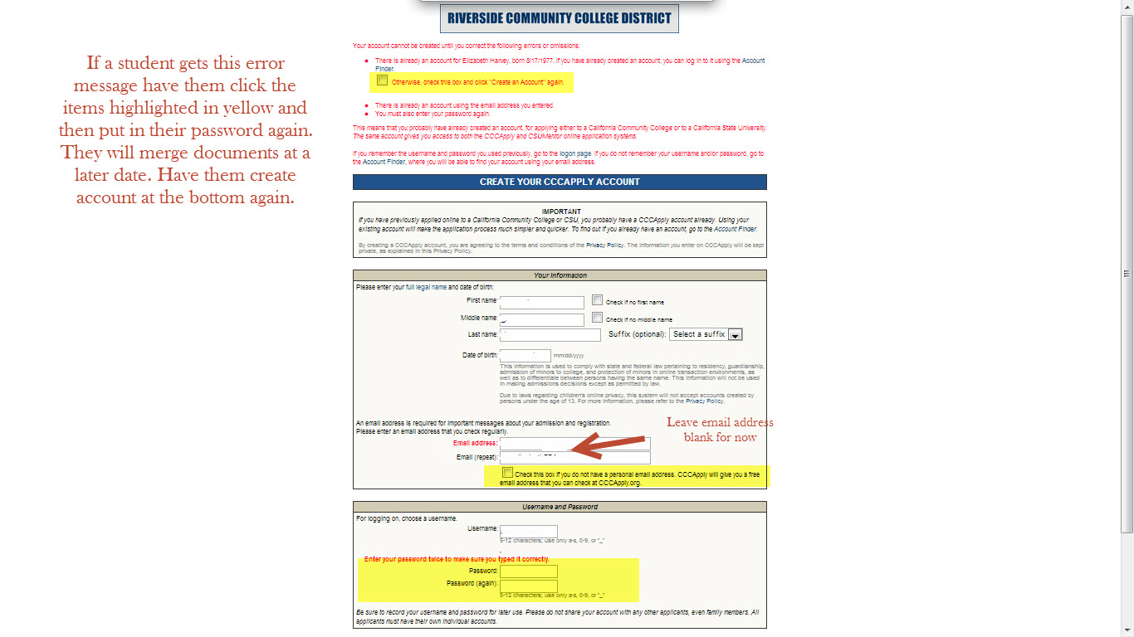

Slide 9
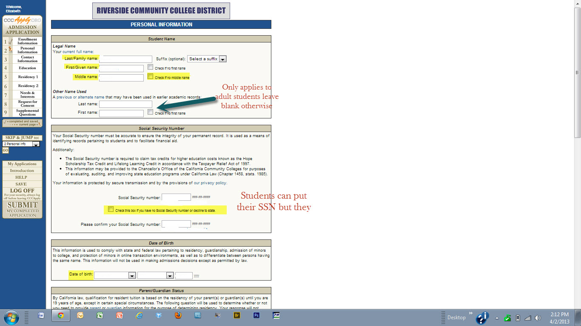
Personal Information Page Section 1

Slide 10
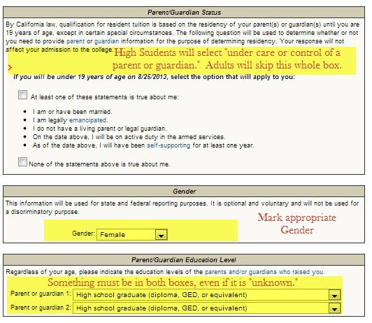
Personal Information Page Section 2

Slide 11
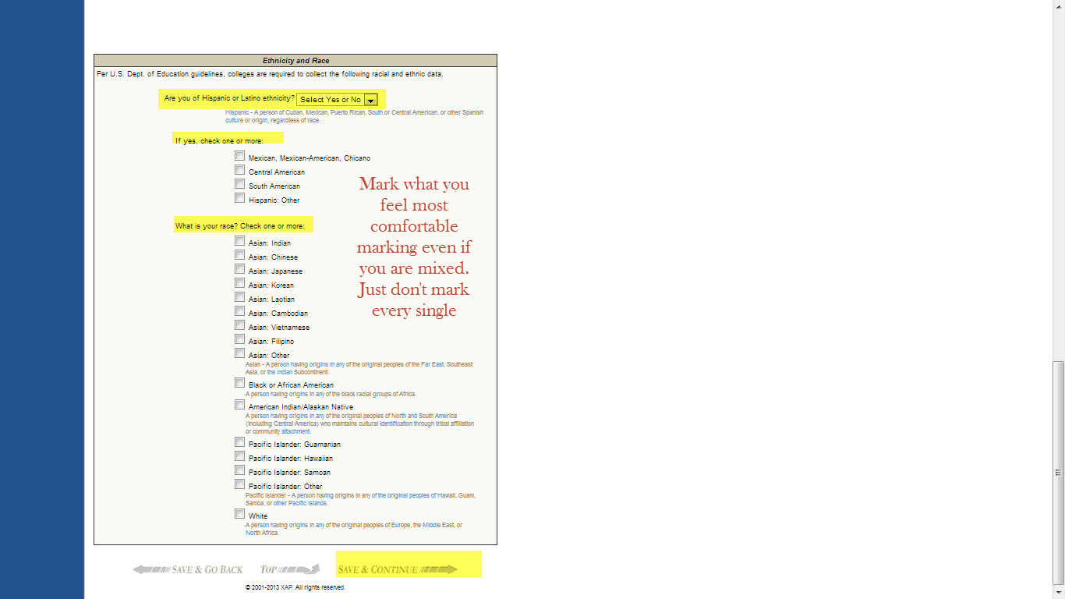
Personal Information Page Section 1
Mark what you feel most comfortable with, even if you are mixed. Just don’t mark every single box in this area.

Slide 12
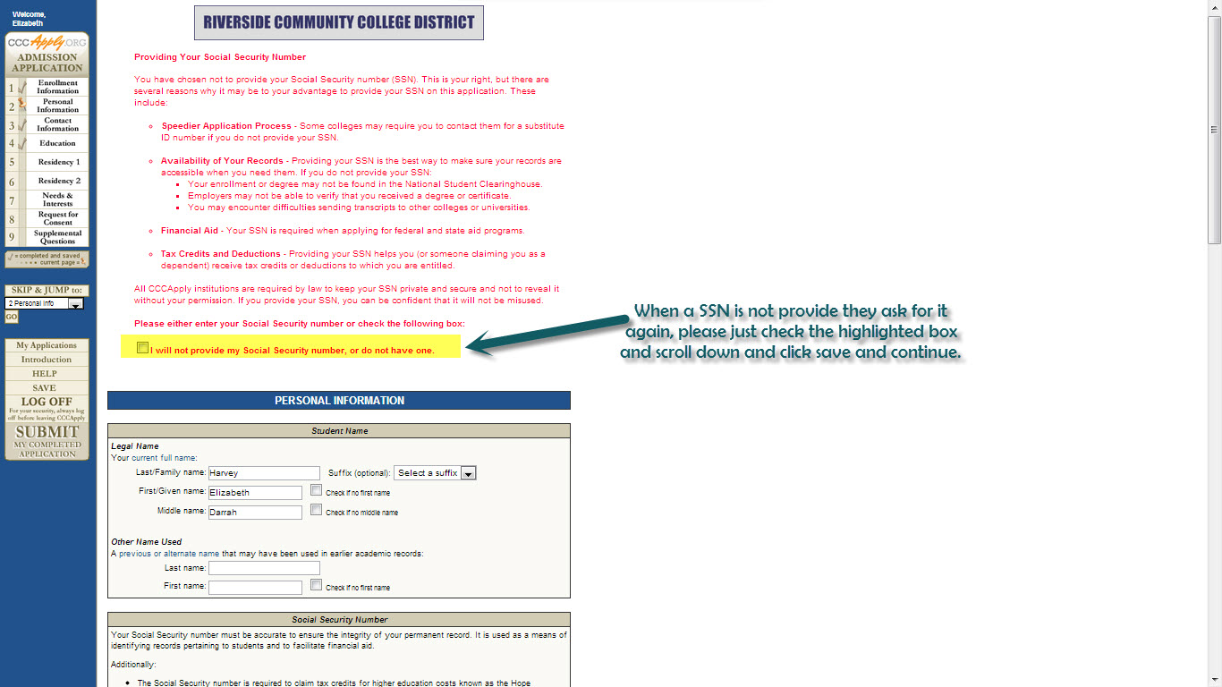

Slide 13
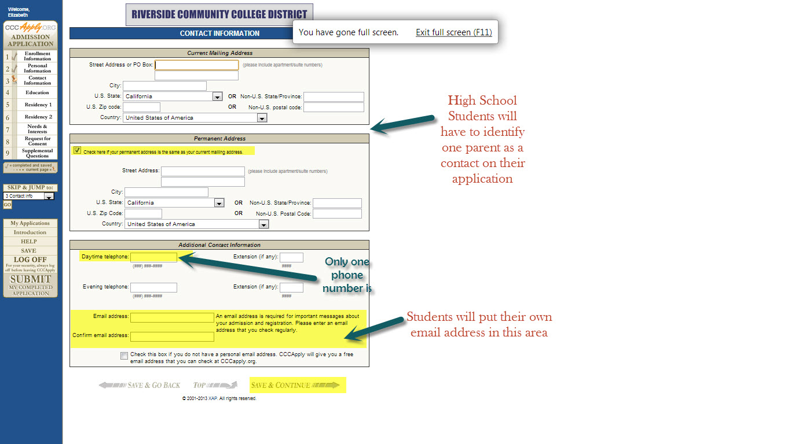
Only one phone number is necessary

Slide 14
Skip Page if you Don’t have Seniors or Adults

Slide 16
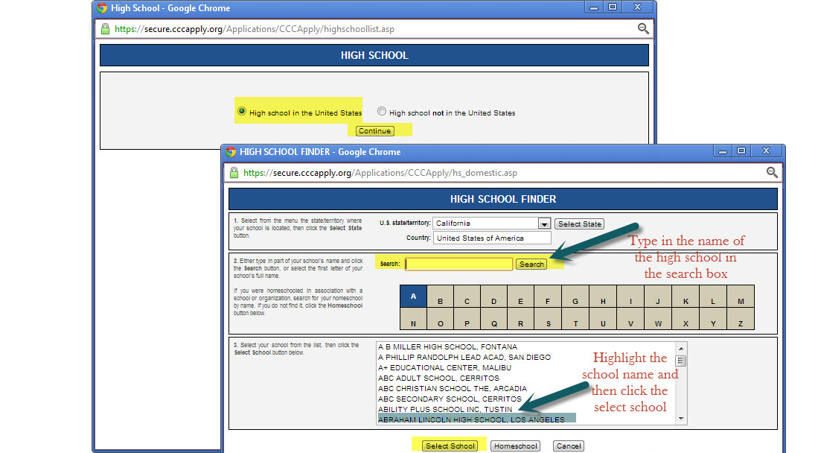

Slide 17
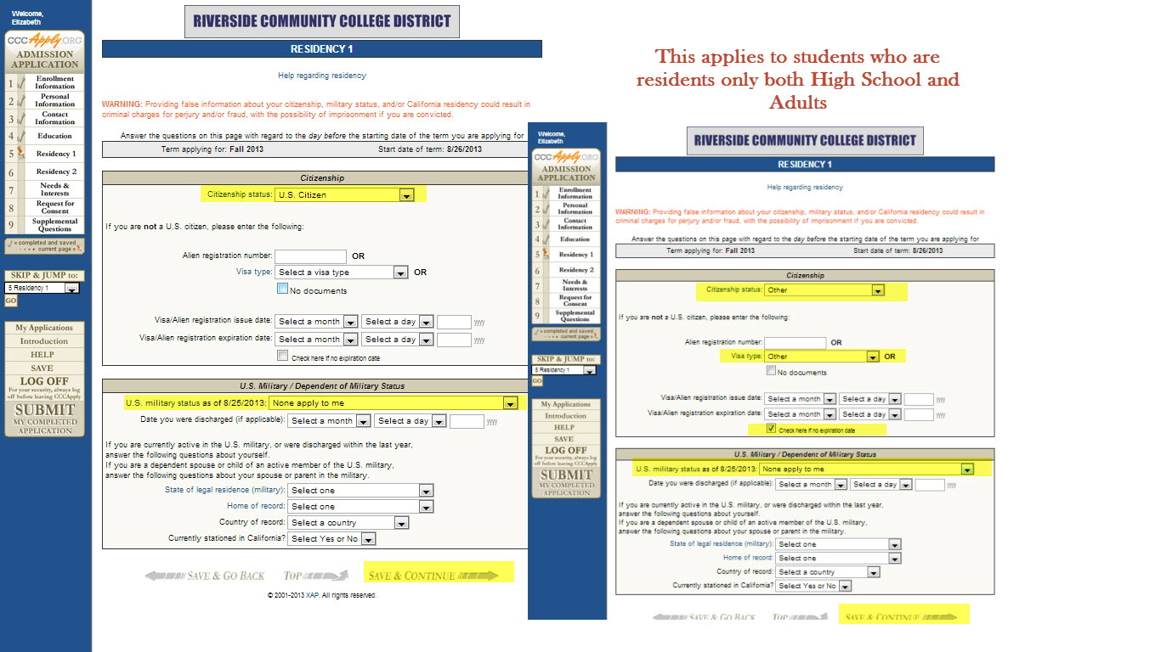

Slide 18
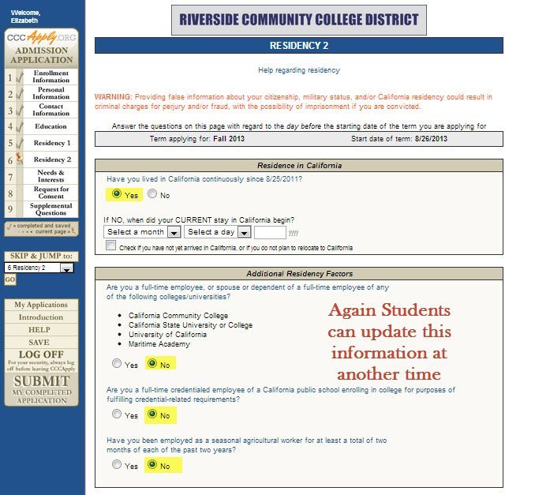
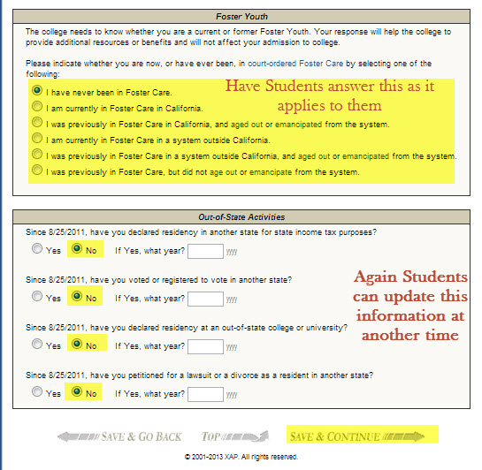
Download a copy of articulated courses by districtxxxxxxxxxxxxx

Slide 19
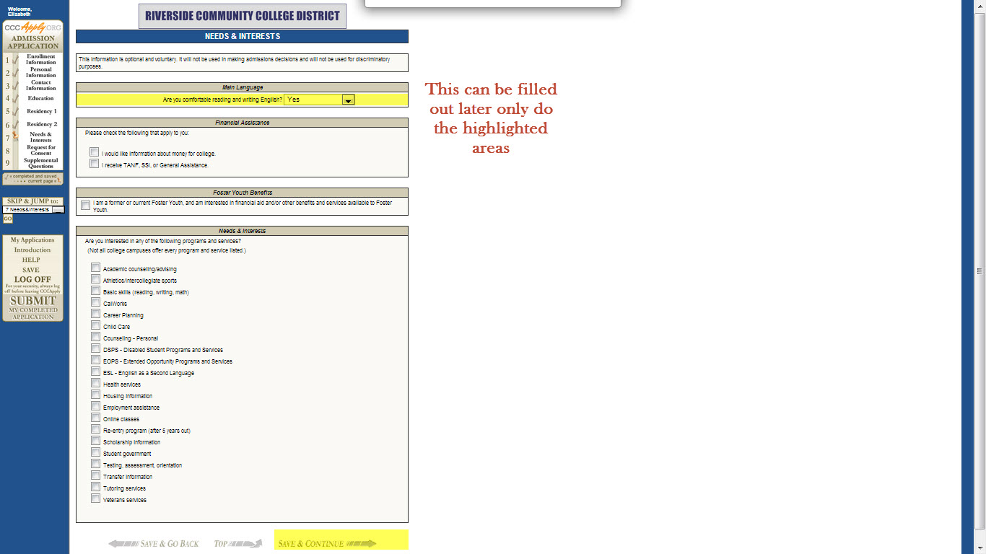

Slide 21
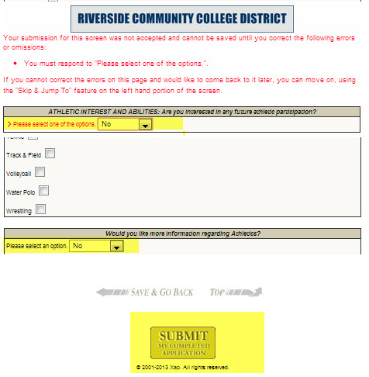

Slide 22
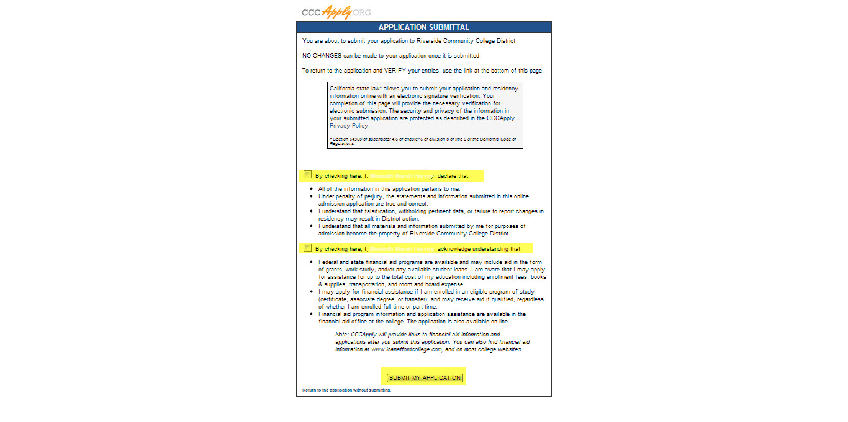

Slide 23
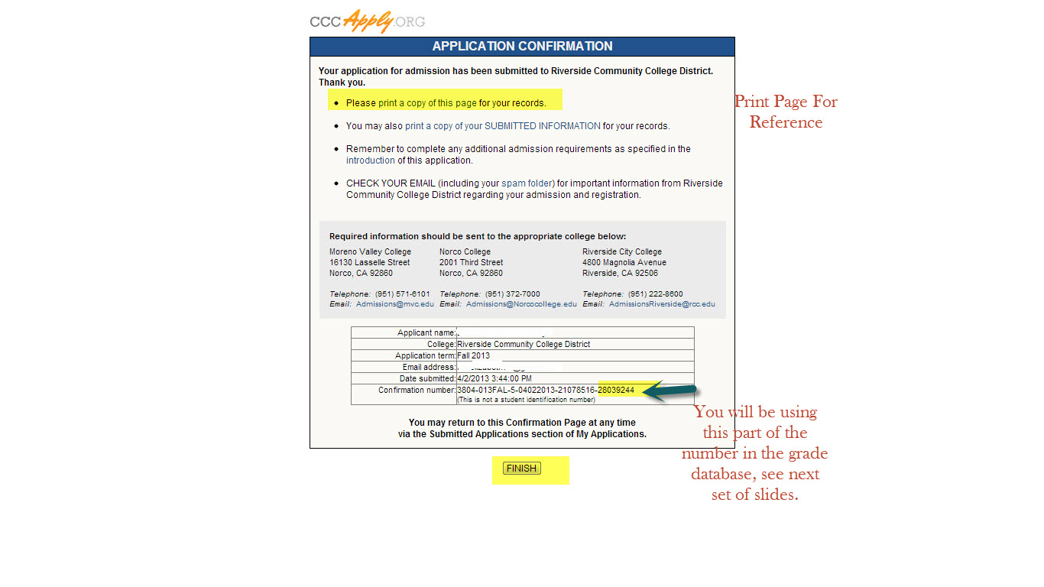

Slide 24
Contact RCCD Projects Office
Before you work with your class in the CATEMA system you will need to contact me. The reason is so I can create an account and add your classes in order for your students to enroll themselves in the correct classes. The accuracy in this account will allow us to continue to provide data on articulation and support its efforts.
Elizabeth Harvey
951.334.1477
Elizabeth.harvey@rcc.edu

Slide 25
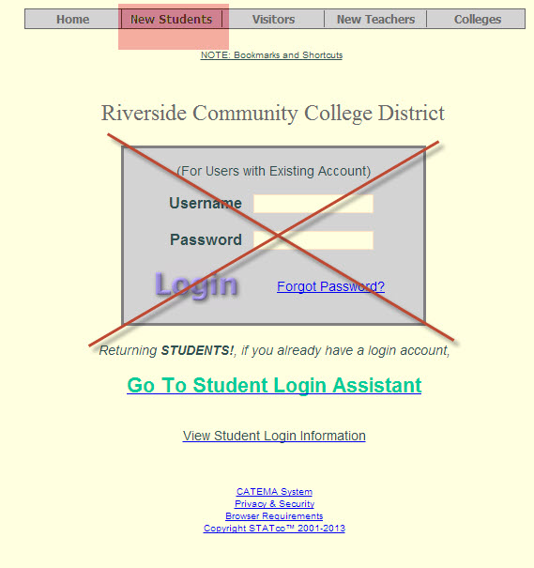
Application Database: www.catema.net/rccd

Slide 26
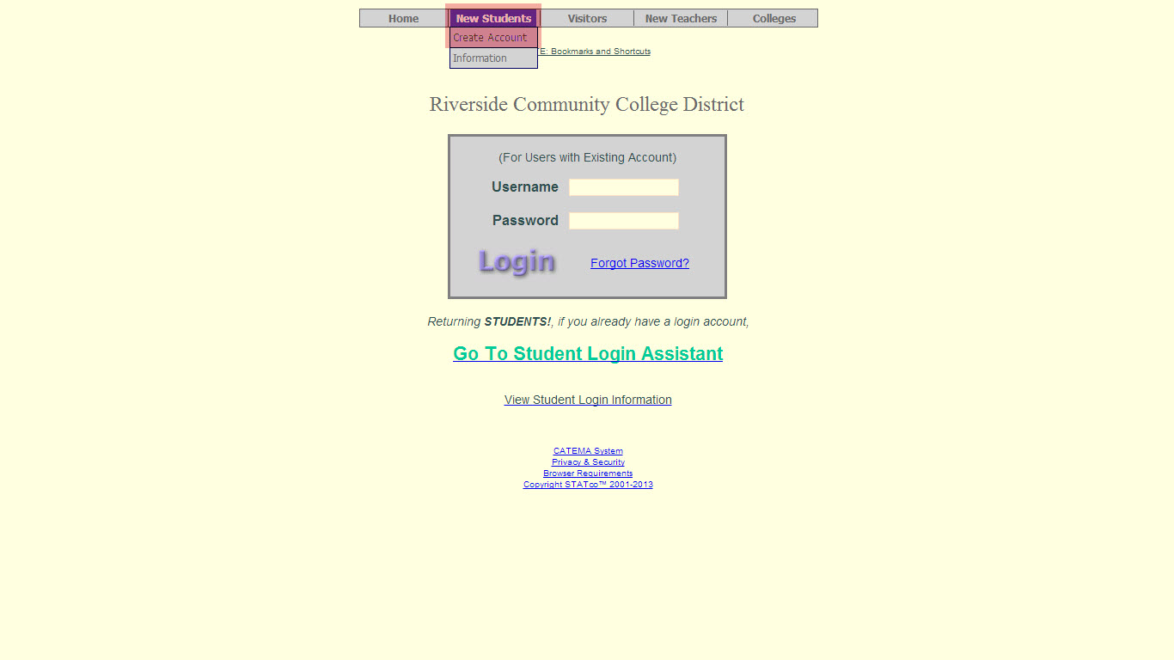

Slide 27
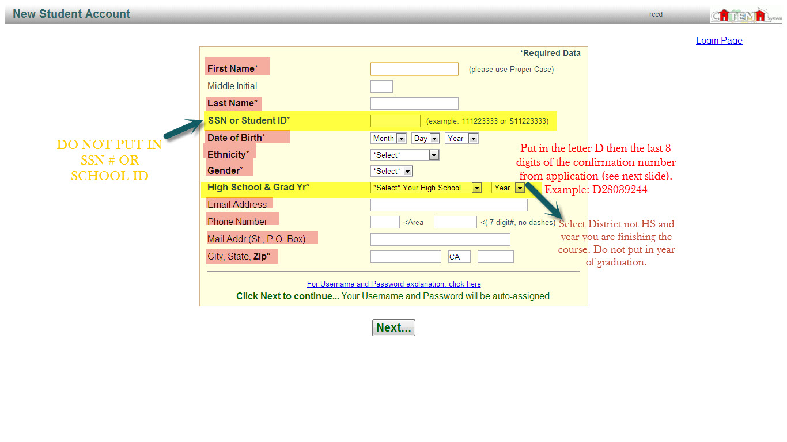

Slide 29
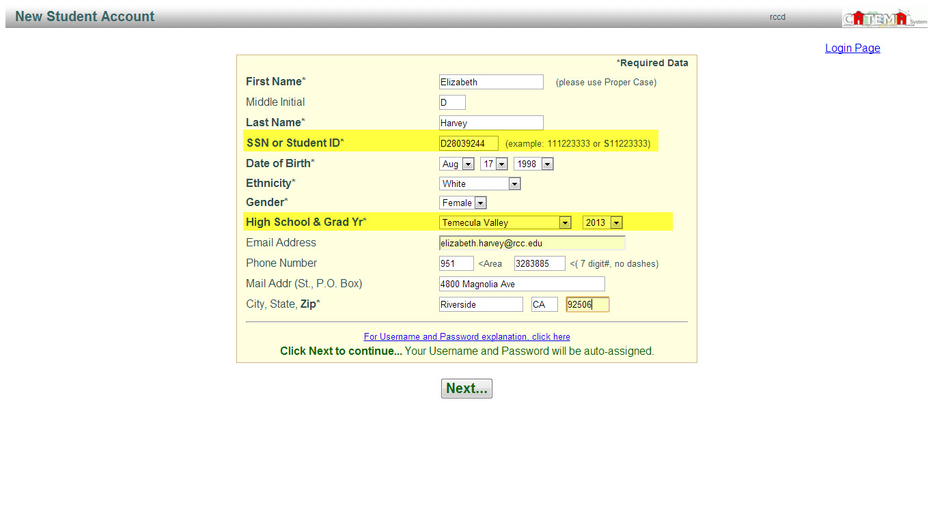

Slide 30
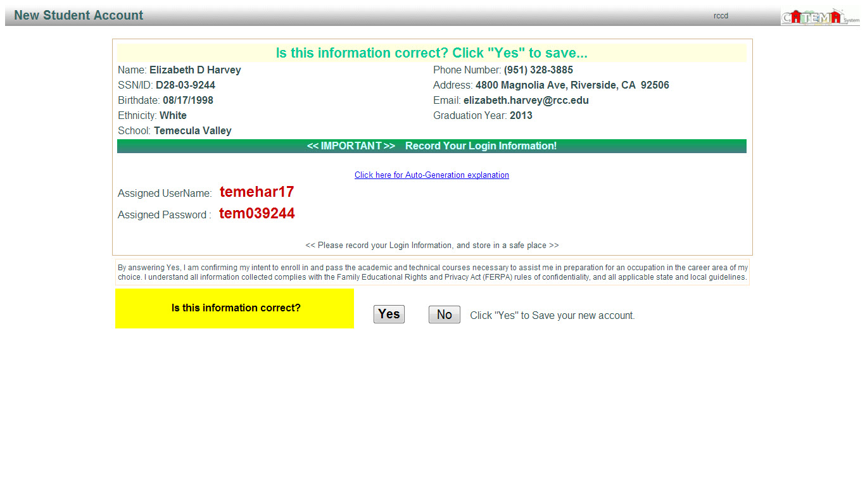
This information will change with RCCD ID number is entered so there is no need to write this down.

Slide 31
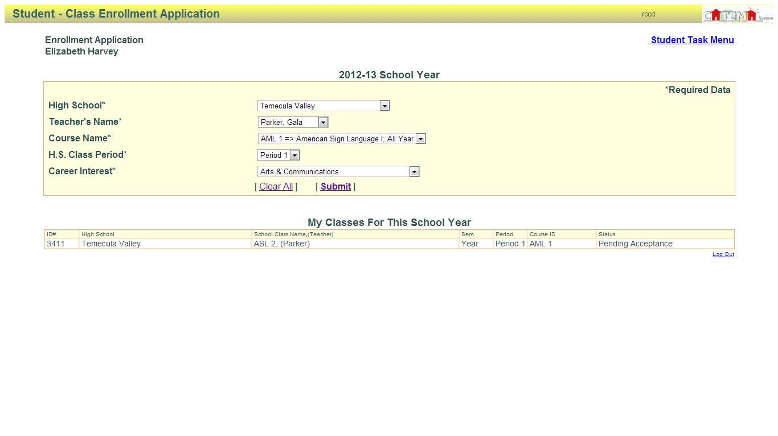
This will only let students select certain options if done correctly. Career interest is anything they are interested in.
When you hit submit it will fill in the information below
Once you see “pending acceptance” you have enrolled in the class and you can “log out”

